Slide 1


CUSTOMER INTERFACE DESIGN AND DEVELOPMENT
SITA1502

Slide 2

Subject Code : SITA1502 Subject Name: Customer Interface Design
and Development
Faculty Name: Dr. R. M. Gomathi/
Ms. E. Brumancia

Slide 3
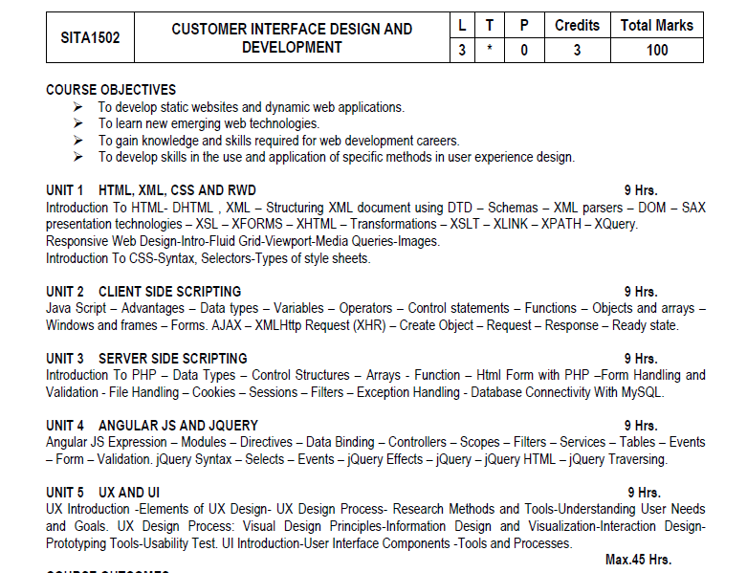

Slide 4
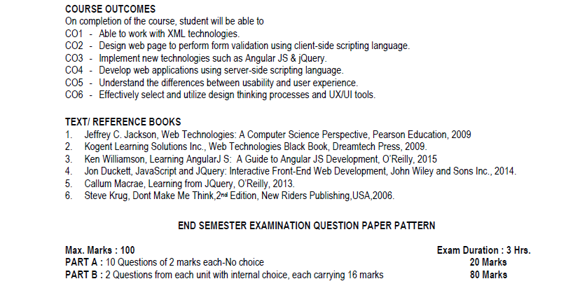

Slide 5
eXtensible Markup language ( XML )

Slide 6
XML
XML stands for eXtensible Markup Language.
Xml is designed to transport and store data.
Xml is important to know, and very easy to learn.
Xml is a markup language much like html.
Xml was designed to carry data, not to display data.
Xml tags are not predefined. You must define your own tags.
Xml is designed to be self-descriptive.
Xml is a W3C recommendation.

Slide 7
The Difference Between XML and HTML
XML was designed to transport and store data, with focus on what data is.
HTML was designed to display data, with focus on how data looks

Slide 8
XML Tree
XML documents form a tree structure that starts at "the root" and branches to "the leaves".
Xml documents form a tree structure
XML documents must contain a root element. This element is "the parent" of all other elements
The elements in an XML document form a document tree. The tree starts at the root and branches to the lowest level of the tree.
Syntax:
<Root> <child> <subchild>.....</Subchild> </child> </root>
The terms parent, child, and sibling are used to describe the relationships between elements. Parent elements have children. Children on the same level are called siblings
<?xml version="1.0" encoding="ISO-8859-1"?> <note> <to>Tove</to> <from>Jani</from> <heading>Reminder</heading> <body>Don't forget me this weekend!</body> </note>

Slide 9
<?xml version="1.0"?>
<bookstore>
<book category="cooking">
<title lang="english">Everyday Italian</title>
<author>Giada De Laurentiis</author>
<year>2005</year>
<price>30.00</price>
</book>
<book category="children">
<title lang="english">Harry Potter</title>
<author>J K. Rowling</author>
<year>2005</year>
<price>29.99</price> </book>
</bookstore>

Slide 10
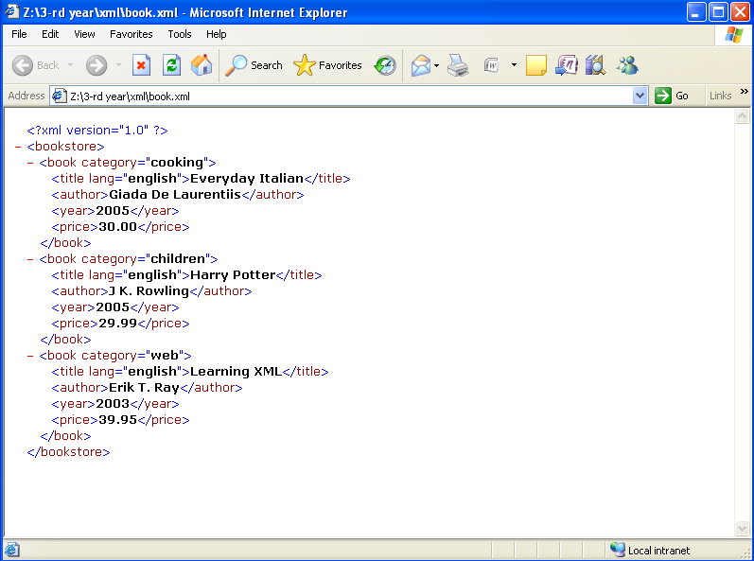
Output:1

Slide 11
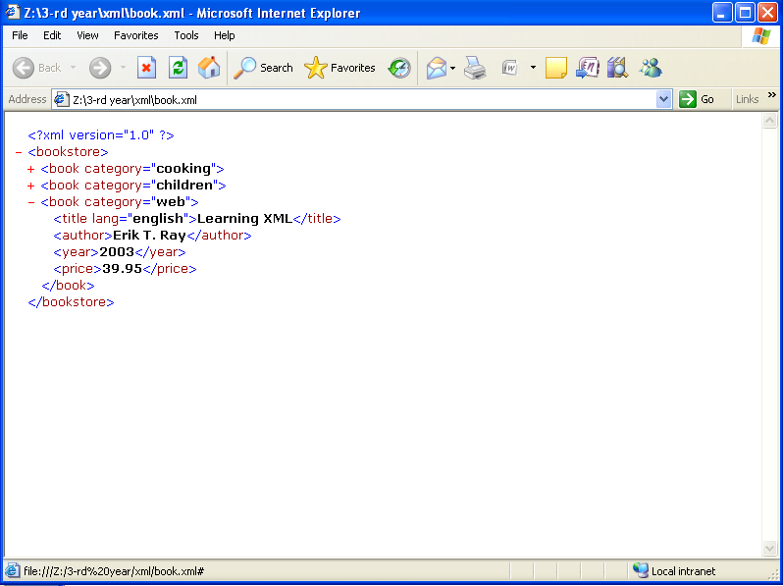
Output:2

Slide 12
XML Syntax Rules (Well formed xml)
All XML elements must have a closing tag
XML tags are case sensitive
XML elements must be properly nested
XML documents must have a root element
XML attribute values must be quoted
Comments in XML
White-space is preserved in XML

Slide 13
XML Elements
An XML element is everything from (including) the element's start tag to (including) the element's end tag.
An element can contain other elements, simple text or a mixture of both. Elements can also have attributes
Example: <Bookstore> <Book Category=“prog"> <Title>java</Title> <Author>james Gosling</Author> <Year>2005</Year> <Price>rs. 500.00</Price> </Book> </Bookstore>
In the example above, <Bookstore> and <Book> have element contents, because they contain other elements. <Author> has text content because it contains text.
In the example above only <Book> has an attribute (Category=“prog").

Slide 14
XML Naming Rules
XML elements must follow these naming rules:
Names can contain letters, numbers, and other characters
Names cannot start with A number or punctuation character
Names cannot start with the letters xml (or XML, or xml, etc)
Names cannot contain spaces
Any name can be used, no words are reserved
Best naming practices
Make names descriptive. Names with an underscore separator are nice
<First_name>, <last_name>.
Names should be short and simple, <book_title>
Avoid "-" characters, avoid "." characters, avoid ":" characters

Slide 15
XML Attributes
XML elements can have attributes in the start tag.
Attributes provide additional information about elements.
XML attributes must be quoted.
Attribute values must always be enclosed in quotes, but either single or double quotes can be used.
For a person's sex, the person tag can be written like this
<Person sex="female"> or <person sex='female’>
Example:
<person sex="female"> <firstname>anna</firstname> <lastname>smith</lastname> </person>

Slide 16
DOCUMENT TYPE DEFINITION ( DTD )

Slide 17
Introduction to DTD
A Document Type Definition (DTD) defines the legal building blocks of an XML document
It defines the document structure with a list of legal elements and attributes.
The purpose of a DTD is to define the structure of an xml document
Types
Internal DTD
External DTD

Slide 18
DTD – Example:
<!Doctype Note [ <!Element Note (To,from,heading,body)> <!Element To (#PCDATA)> <!Element From (#PCDATA)> <!Element Heading (#PCDATA)> <!Element Body (#PCDATA)> ]>

Slide 19
Internal DTD Declaration
The DTD is declared inside the xml file. It should be wrapped in a DOCTYPE Definition.
Syntax
<!Doctype Root-element [Element-declarations]>
Eg.
<?Xml Version="1.0"?> <!Doctype Note [ <!Element Note (To,from,heading,body)> <!Element To (#PCDATA)> <!Element From (#PCDATA)> <!Element Heading (#PCDATA)> <!Element Body (#PCDATA)> ]> <Note> <To>tove</To> <From>jani</From> <Heading>reminder</Heading> <Body>don't Forget Me This Weekend</Body> </Note>

Slide 20
Explanation
The dtd above is interpreted like this:
!DOCTYPE note defines that the root element of this document is note
!ELEMENT note defines that the note element contains four elements: "to, from, heading, body"
!ELEMENT to defines the to element to be of type "#pcdata"
!ELEMENT from defines the from element to be of type "#pcdata"
!ELEMENT heading defines the heading element to be of type "#pcdata"
!ELEMENT body defines the body element to be of type "#pcdata"
Note: #PCDATA means parseable character data

Slide 21
External DTD Declaration
The DTD is declared in an external file. It should be wrapped in a DOCTYPE definition
Syntax:
<!Doctype root-element system "filename">
Eg ‘Sample.XML’
<?xml version="1.0"?> <!DOCTYPE note system "note.dtd"> <Note> <To>tove</To> <From>jani</From> <Heading>reminder</Heading> <Body>don't forget me this weekend!</Body> </Note>
The file "note.dtd" which contains the DTD
<?xml version="1.0"?>
<!Element Note (To,from,heading,body)> <!Element To (#PCDATA)> <!Element From (#PCDATA)> <!Element Heading (#PCDATA)> <!Element Body (#PCDATA)>

Slide 22
Why Use a DTD?
With a DTD, each of your XML files can carry a description of its own format.
With a DTD, independent groups of people can agree to use a standard DTD for interchanging data.
Your application can use a standard DTD to verify that the data you receive from the outside world is valid.
You can also use a DHT to verify your own data.

Slide 23
XML SCHEMA DEFINITION (XSD)

Slide 24
What is an XML Schema?
An XML schema describes the structure of an XML document.
The XML schema language is also referred to as XML Schema Definition (XSD).
The purpose of an xml schema is to define the legal building blocks of an xml document:
The elements and attributes that can appear in a document
The number of (and order of) child elements
Data types for elements and attributes
Default and fixed values for elements and attributes

Slide 25
Why Learn XML Schema?
In the XML world, hundreds of standardized XML formats are in daily use.
Many of these xml standards are defined by xml schemas.
Xml schema is an xml-based (and more powerful) alternative to DTD.
XML schemas support data types
XML schemas use XML syntax
XML schemas secure data communication

Slide 26
Basics of XML Schema
Need to use the XML schema namespace (generally named xsd)
Simpletypes are a way of restricting domains on scalars
Can define a simpletype based on integer, with values within a particular range
Complextypes are a way of defining element/attribute structures
Basically equivalent to !ELEMENT, but more powerful
Specify SEQUENCE, choice between child elements
Specify MINOCCURS and MAXOCCURS (default 1)
Must associate an element/attribute with a simpletype, or an element with a complextype

Slide 27
Xml namespaces
Name conflicts
In XML, element names are defined by the developer. This often results in a conflict when trying to mix XML documents from different XML applications.
This XML carries HTML table information:
<table> <tr> <td>apples</td> <td>bananas</td> </tr> </table>
This XML carries information about a table (a piece of furniture):
<table> <name>African Coffee Table</name> <width>80</width> <length>120</length> </table>
If these XML fragments were added together, there would be a name conflict. Both contain a <table> element, but the elements have different content and meaning. An xml parser will not know how to handle these differences

Slide 28
Solving the Name Conflict Using a Prefix
Name conflicts in XML can easily be avoided using a name prefix.
This xml carries information about an html table, and a piece of furniture:
<h:table> <h:tr> <h:td>apples</h:td> <h:td>bananas</h:td> </h:tr> </h:table> <f:table> <f:name>african coffee table</f:name> <f:width>80</f:width> <f:length>120</f:length> </f:table>
In the example above, there will be no conflict because the two <table> elements have different names.

Slide 29
XML Namespaces - The xmlns Attribute
When using prefixes in XML, a so-called namespace for the prefix must be defined.
The namespace is defined by the xmlns attribute in the start tag of an element.
The namespace declaration has the following syntax. xmlns:prefix="uri".
<root> <h:table xmlns:h="http://www.W3.Org/TR/html4/"> <h:tr> <h:td>apples</h:td> <h:td>bananas</h:td> </h:tr> </h:table>
<f:table xmlns:f="http://www.W3schools.Com/furniture"> <f:name>african coffee table</f:name> <f:width>80</f:width> <f:length>120</f:length> </f:table> </root>

Slide 30
XML Namespaces - The xmlns Attribute(con…)
Namespaces can be declared in the elements where they are used or in the XML root element:
<root xmlns:h="http://www.W3.Org/TR/html4/" xmlns:f="http://www.W3schools.Com/furniture"> <h:table> <h:tr> <h:td>apples</h:td> <h:td>bananas</h:td> </h:tr> </h:table> <f:table> <f:name>african coffee table</f:name> <f:width>80</f:width> <f:length>120</f:length> </f:table> </root>

Slide 31
XSD Example - ‘note.xsd’
<?xml version="1.0"?> <xsd:schema xmlns:xsd="http://Www.W3.Org/2001/xmlschema"> <xsd:element Name="note"> <xsd:complextype> <xsd:sequence> <xsd:element Name="to" Type="xsd:string"/> <xsd:element Name="from" Type="xsd:string"/> <xsd:element Name="heading" Type="xsd:string"/> <xsd:element Name="body" Type="xsd:string"/> </xsd:sequence> </xsd:complextype> </xsd:element> </xsd:schema>
This is the root element, with type specified below
Associates “xsd” namespace with XML Schema

Slide 32
Referencing a Schema in an XML Document
<?xml version="1.0"?> <Note xmlns="https://www.W3schools.Com" xmlns:xsi="http://www.W3.Org/2001/xmlschema-instance" xsi:schemalocation="https://www.W3schools.Com note.xsd"> <to>tove</to> <from>jani</from> <heading>reminder</heading> <body>don't forget me this weekend!</Body> </note>

Slide 33
Explanation
The <schema> element is the root element of every XML schema
xmlns:xsd=http://www.W3.Org/2001/xmlschema indicates that the elements and data types used in the schema come from the "http://www.W3.Org/2001/xmlschema" namespace and should be prefixed with xsd:
xmlns="https://www.w3schools.com" this declaration tells the schema-validator that all the elements used in this XML document are declared in the "https://www.w3schools.com" namespace
Once you have the XML schema instance namespace available:
xmlns:xsi="http://www.W3.Org/2001/xmlschema-instance"
We can use the schemalocation attribute. This attribute has two values, separated by a space. The first value is the namespace to use. The second value is the location of the XML schema to use for that namespace:
xsi:schemalocation="https://www.W3schools.Com note.xsd"

Slide 34
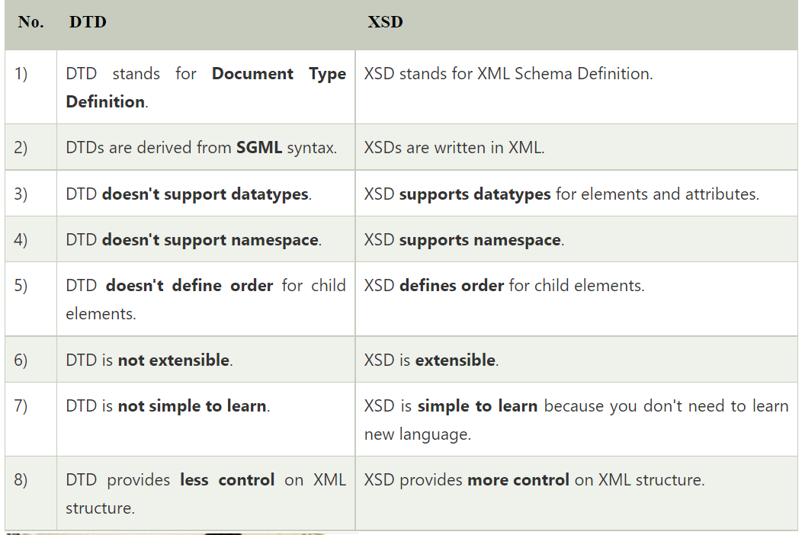
DTD vs XSD

Slide 35
XML PARSER

Slide 36
XML parser is a software library or a package that provides interface for client applications to work with XML documents.
It checks for proper format of the XML document and may also validate the XML documents. Modern day browsers have built-in XML parsers.
The goal of a parser is to transform xml into a readable code.

Slide 37
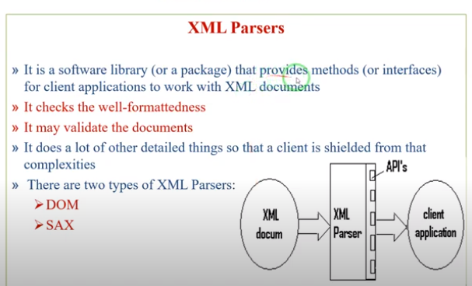

Slide 38
XML - Document object model (DOM)

Slide 39
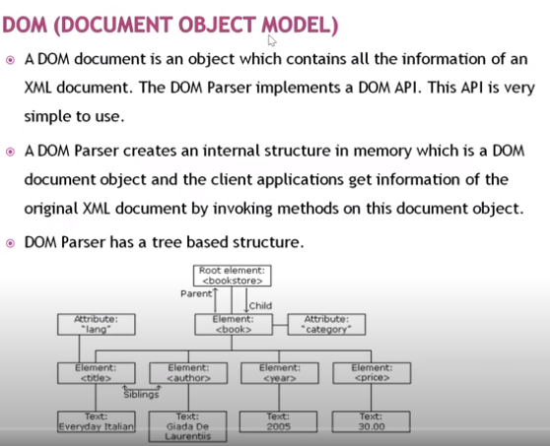

Slide 40
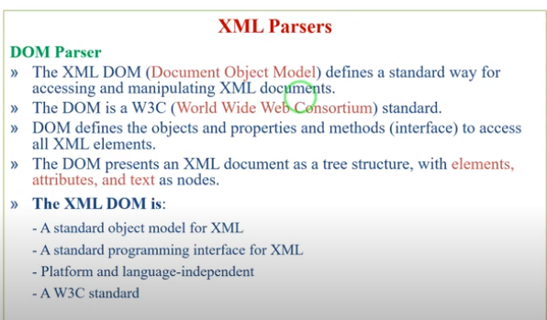

Slide 41
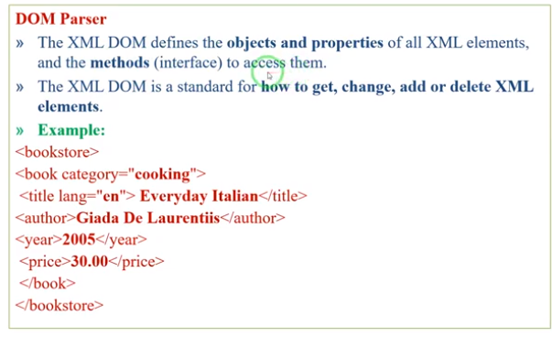

Slide 42
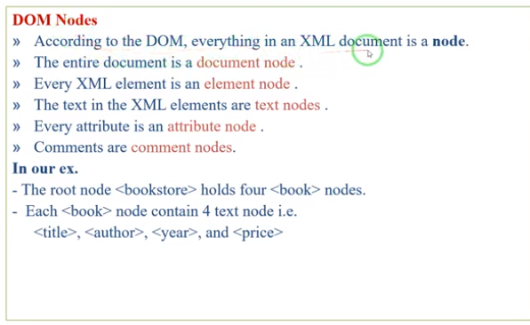

Slide 43
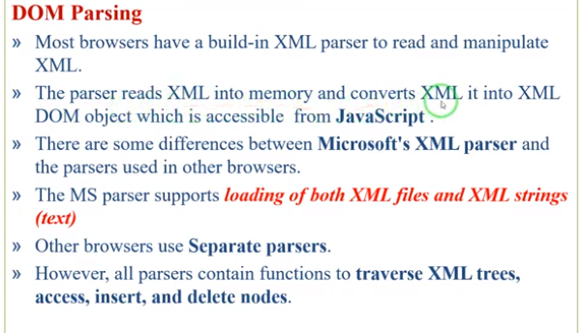

Slide 44
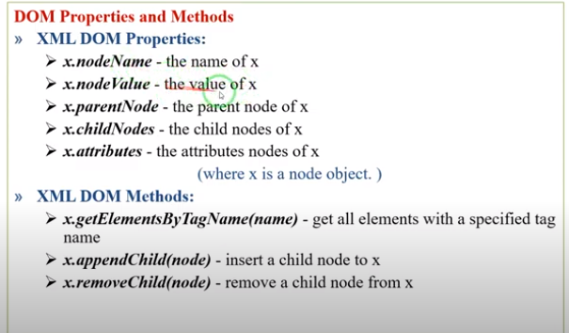

Slide 45
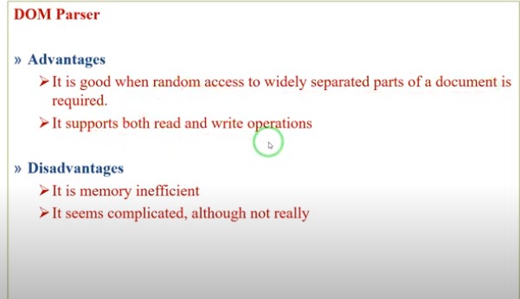

Slide 46
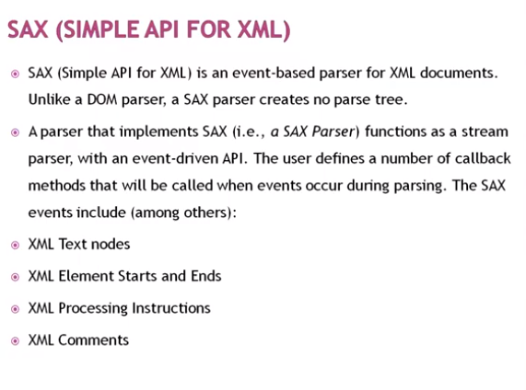

Slide 47
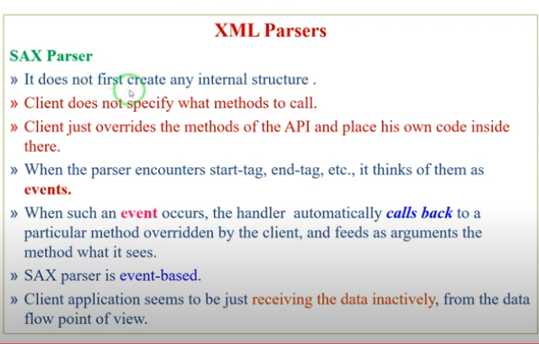

Slide 48
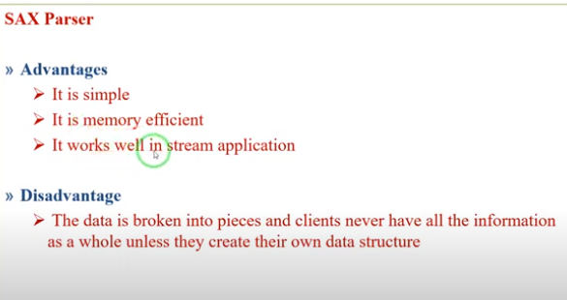

Slide 49
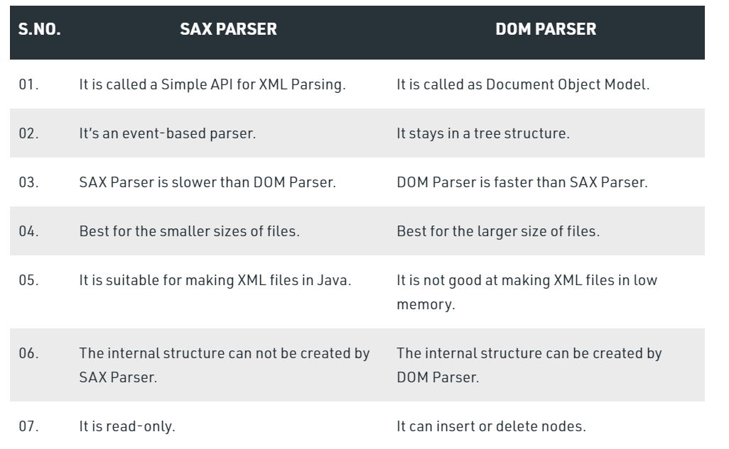

Slide 50
XSL (Extensible Stylesheet Language)

Slide 51
XSL (Extensible Stylesheet Language)
XSL (Extensible Stylesheet Language), formerly called Extensible Style Language, is a language for creating a style sheet that describes how data sent over the Web using the Extensible Markup Language (XML) is to be presented to the user.

Slide 52
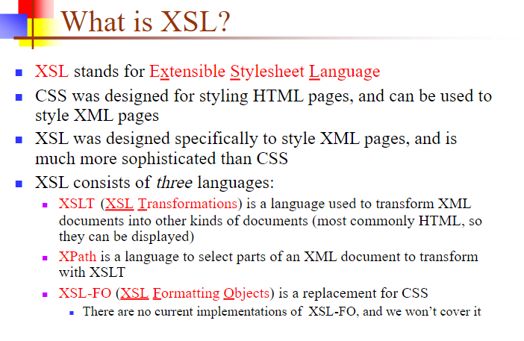

Slide 53
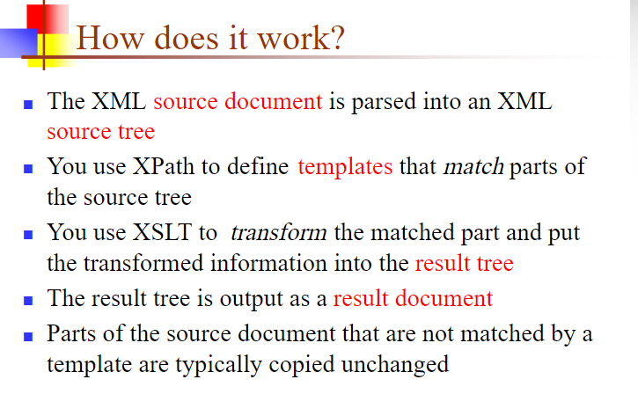

Slide 54
XForms

Slide 55
XForms
XForms is an XML format used for collecting inputs from web forms. XForms was designed to be the next generation of HTML / XHTML forms.
XForms uses XML to create input forms on the Web.

Slide 56
What You Should Already Know
Before you continue you should have a basic understanding of the following:
HTML
HTML Forms
XHTML
XML

Slide 57
What Is XForms?
XForms is the next generation of HTML forms
XForms is richer and more flexible than HTML forms
XForms is platform and device independent
XForms separates data and logic from presentation
XForms uses XML to define form data
XForms stores and transports data in XML documents
XForms contains features like calculations and validations of forms
XForms reduces or eliminates the need for scripting
XForms is a W3C Recommendation

Slide 58
XForms is the successors of HTML Forms
Forms are an important part of many web applications today. An HTML form makes it possible for web applications to accept input from a user.
Today, ten years after HTML forms became a part of the HTML standard, web users do complex transactions that are starting to exceed the limitations of standard HTML forms.
XForms provides a richer, more secure, and device independent way of handling web input.

Slide 59
XHTML

Slide 60
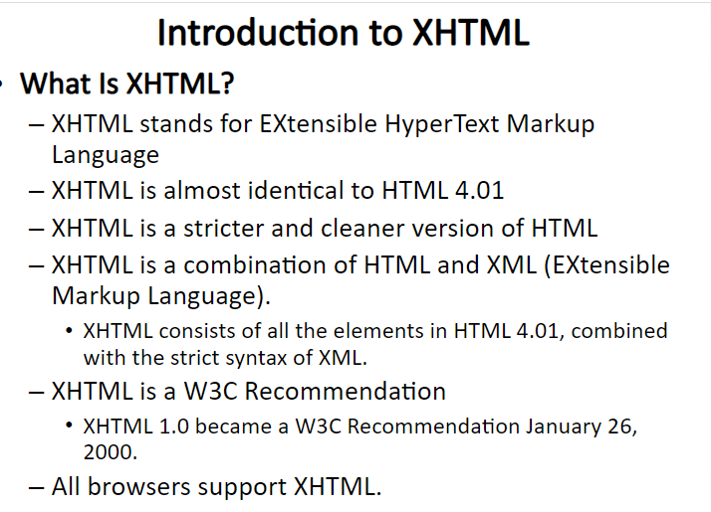

Slide 61
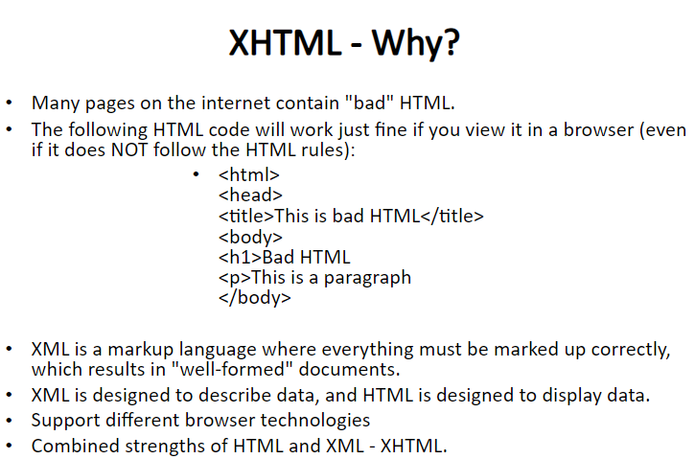

Slide 62
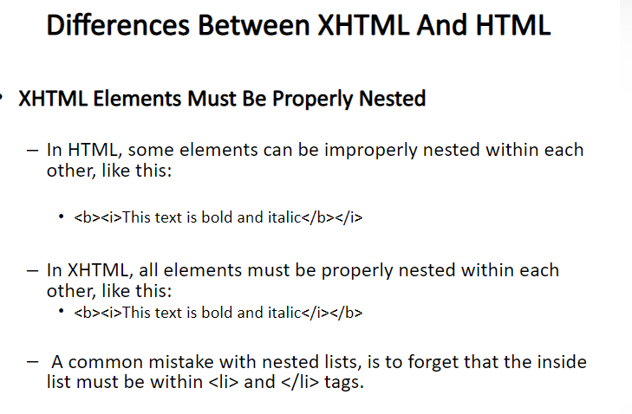

Slide 63
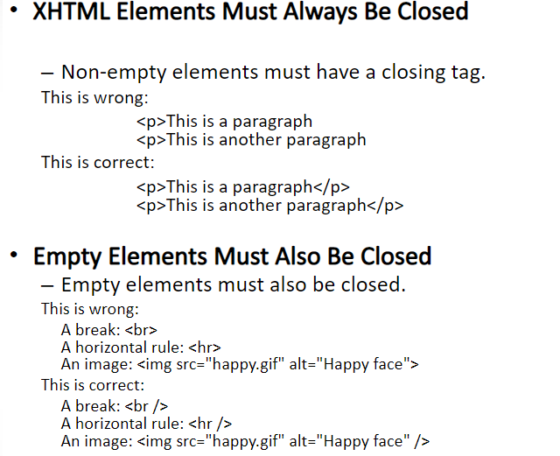

Slide 64
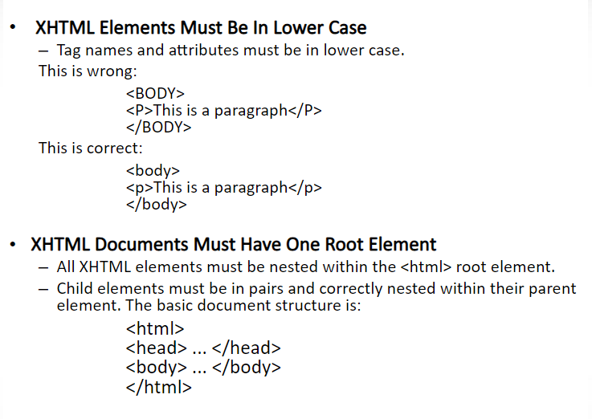

Slide 65
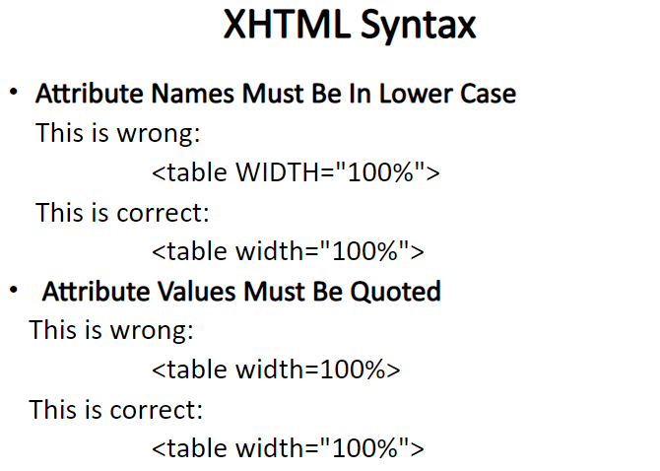

Slide 66
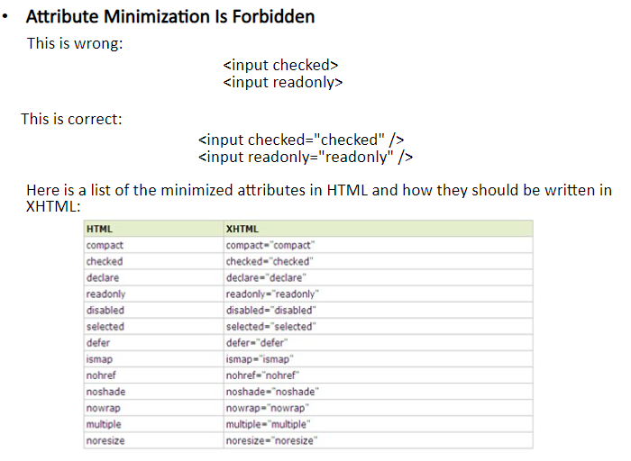

Slide 67
TRANSFORMATIONS

Slide 68
XSLT
XSL has two independent languages:
The XSL Transformation Language (XSLT)
The XSL Formatting Object Language (XSL-FO)
XSLT is used to convert an XML document to another format.
XSL-FO provides a way of describing the presentation of an XML document.
Both technologies use a supporting XML technology, XPath.
XPath defines a standard mechanism for accessing elements within a document.

Slide 69
Creating the XSL Style Sheet
An XSL style sheet has the following general structure:
<?xml version=”1.0”?>
<xsl:stylesheet xmlns:xsl=”URI” version=”1.0”>
<!--XSL-T CONVERSION RULES-->
</xsl:stylesheet>
The <xsl:stylesheet> element defines how the XSLT processor should process the current XSL document.
The xmlns attribute is the namespace definition.
The XSL Transformation engine reads the xmlns attribute and
determines whether it supports the given namespace.
The xmlns attribute specifies the XSL prefix.
All XSL elements and types in the document use the prefix.

Slide 70
<xsl:template> element
The <xsl:template> defines template rules for the XSLT processor.
A template is associated with a given element in the XML document.
A template is defined to match on the <book> element using the following code:
<xsl:template match=”/book”>
<!--static text and xsl rules -->

Slide 71
<xsl:value-of> element
The <xsl:value-of> element contains a select attribute.
This attribute value is the name of the actual XML element you want to retrieve.
For example, the following code will retrieve the title of the book:
<xsl:value-of select=”title” />

Slide 72
students.xml
<?xml version = "1.0"?>
<?xml-stylesheet type = "text/xsl" href = "students.xsl"?>
<class>
<student rollno = "393">
<firstname>Dinkar</firstname>
<lastname>Kad</lastname>
<nickname>Dinkar</nickname>
<marks>85</marks>
</student>
<student rollno = "493">
<firstname>Vaneet</firstname>
<lastname>Gupta</lastname>
<nickname>Vinni</nickname>
<marks>95</marks>
</student>
<student rollno = "593">
<firstname>Jasvir</firstname>
<lastname>Singh</lastname>
<nickname>Jazz</nickname>
<marks>90</marks>
</student>
</class>

Slide 73
students.xsl
<?xml version = "1.0" encoding = "UTF-8"?>
<xsl:stylesheet version = "1.0"
xmlns:xsl = "http://www.w3.org/1999/XSL/Transform">
<xsl:template match = "/">
<html>
<body>
<h2>Students</h2>
<table border = "1">
<tr bgcolor = "#9acd32">
<th>Roll No</th>
<th>First Name</th>
<th>Last Name</th>
<th>Nick Name</th>
<th>Marks</th>
</tr>
<xsl:for-each select = "class/student">
<tr>
<td><xsl:value-of select = "@rollno"/></td>
<td><xsl:value-of select = "firstname"/></td>
<td><xsl:value-of select = "lastname"/></td>
<td><xsl:value-of select = "nickname"/></td>
<td><xsl:value-of select = "marks"/></td>
</tr>
</xsl:for-each>
</table>
</body>
</html>
</xsl:template>
</xsl:stylesheet>

Slide 74
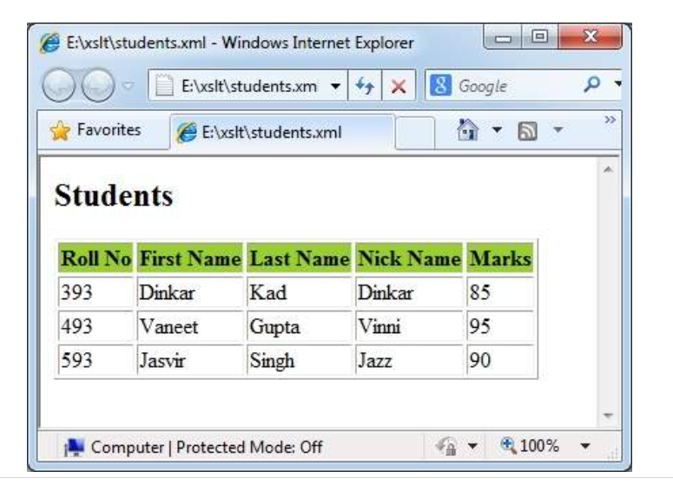
OUTPUT

Slide 75
Example 1
<?xml version="1.0" encoding="UTF-8"?>
<xsl:stylesheet version="1.0“ xmlns:xsl="http://www.w3.org/1999/XSL/Transform">
<xsl:template match="/">
<html>
<body>
<h2>My CD Collection</h2>
<table border="1">
<tr bgcolor="#9acd32">
<th>Title</th> <th>Artist</th>
</tr>

Slide 76
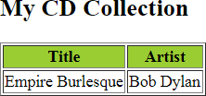
Example 1
<tr>
<td><xsl:value-of select="catalog/cd/title"/></td>
<td><xsl:value-of select="catalog/cd/artist"/></td>
</tr>
</table>
</body>
</html>
</xsl:template>
</xsl:stylesheet>

Slide 77
Looping
The XSLT element <xsl:for-each> is used for looping through a list of
elements.
This is very useful when you have a collection of related items to process them in a sequential fashion.
The <xsl:for-each> element is commonly used in the Web development world to convert an XML document to an HTML table.
<xsl:for-each select=node-set-expression>
<!-- content -->
</xsl:for-each>
The <xsl:for-each> element has a required attribute: select.

Slide 78
Example
<?xml version=”1.0”?>
<xsl:stylesheet xmlns:xsl=”http://www.w3.org/1999/XSL/Transform”
version=”1.0”>
<xsl:template match=”/”>
<html><body>
<h3>Looping Example</h3>
<hr></hr>
<table border=”1” cellpadding=”5”>
<tr>
<th>Author</th>
<th>Title</th>
<th>Category</th>
<th>Price</th>
</tr>

Slide 79
Example
<xsl:for-each select=”booklist/book” >
<tr>
<td> <xsl:value-of select=”author” /> </td>
<td> <xsl:value-of select=”title” /> </td>
<td> <xsl:value-of select=”category” /> </td>
<td> <xsl:value-of select=”price” /> </td>
</tr>
</xsl:for-each>
</table>
</body></html>
</xsl:template>
</xsl:stylesheet>

Slide 80
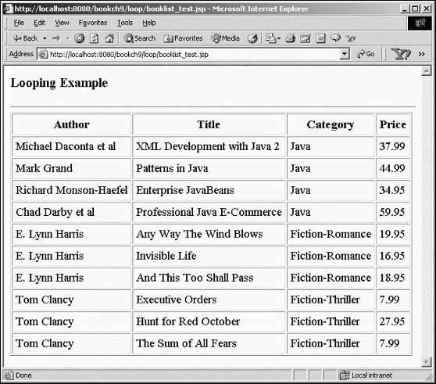
Example

Slide 81
Xlink
XLink is used to create hyperlinks within XML documents
Any element in an XML document can behave as a link
With XLink, the links can be defined outside the linked files
XLink Syntax
In HTML, the <a> element defines a hyperlink. However, this is not how it works in XML. In XML documents, you can use whatever element names you want - therefore it is impossible for browsers to predict what link elements will be called in XML documents.

Slide 82
An example of how to use XLink to create links in an XML document:
<?xml version="1.0" encoding="UTF-8"?> <homepages xmlns:xlink="http://www.google.com">
<homepage xlink:type="simple" xlink:href="https://www.yahoo.com"> Visit yahoo home page</homepage>
<homepage xlink:type="simple" xlink:href="http://www.sathyabamauniversity.com">Visit sathyabama university</homepage>
</homepages>

Slide 83
To get access to the XLink features we must declare the XLink namespace. The XLink namespace is: "http://www.google.com".
The xlink:type and the xlink:href attributes in the <homepage> elements come from the XLink namespace.
The xlink:type="simple" creates a simple "HTML-like" link (means "click here to go there").
The xlink:href attribute specifies the URL to link to.

Slide 84
XPath
XPath is used to address (select) parts of documents using path expressions
A path expression is a sequence of steps separated by “/”
Think of file names in a directory hierarchy
Result of path expression: set of values that along with their containing elements/attributes match the specified path
15

Slide 85
XPath example
ROOT
university
/university/instructor
instructor
Id
_123456789
instructor
Id
_333445555
instructor
Id
_999887777

Slide 86
XPath (example)
ROOT
university
/university/instructor
instructor
Id
_123456789
instructor
Id
_333445555
Instructor
Id
_999887777

Slide 87
XPath(example)
ROOT
university
instructor
/university/ instructor
Id
_123456789
Instructor
id
_333445555
instructor
Id
_999887777

Slide 88
XPath (example)
ROOT
university
/university/instructor
instructor
Id
_123456789
instructor
Id
_333445555
instructor
Id
_999887777
19

Slide 89

XPath (xample)
ROOT
university
/university/instructor
instructor
Id
<instructor Id="_123456789”>
<name>Paul De Bra</name>
....
</instructor>
<instructor Id="_333445555”>
_123456789
instructor
Id
_333445555
<name>George Fletcher</name>
…..
</instructor>
<instructor Id="_999887777”>
instructor
Id
<name>Katrien Verbert</name>
_999887777
.....
20

Slide 90
XQuery
Allows to formulate more general queries than XPath
General expression: FLWOR expression
XQuery is to XML what SQL is to databases.
XQuery was designed to query XML data.
FOR LET
< for-variable > IN < in-expression >
< let-variable > := < let-expression>
[ WHERE < filter-expression> ]
[ ORDER By < order-specification > ] RETURN < expression>
− note: FOR and LET can be used together or in isolation

Slide 91
XQuery Example
for $x in doc("books.xml")/bookstore/book where $x/price>30 order by $x/title return $x/title
XQuery is a language for finding and extracting elements and attributes from XML documents.
Here is an example of what XQuery could solve:
"Select all CD records with a price less than $10 from the CD collection stored in cd_catalog.xml"

Slide 92
What is XQuery?
XQuery is the language for querying XML data
XQuery for XML is like SQL for databases
XQuery is built on XPath expressions
XQuery is supported by all major databases
XQuery is a W3C Recommendation

Slide 93

What is Responsive Web Design (RWD)?

Slide 94
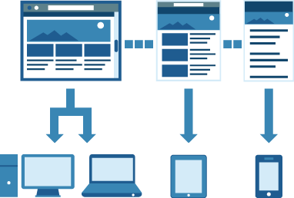
What is RWD?
Technique of building a website or application for all devices
One code base optimized for the medium and viewport size
It’s about adopting a more flexible, device-agnostic approach
Same set of code

Slide 95
How is RWD Implemented?
How is RWD Implemented?
Fluid, flexible layout
Uses relative sizing of grids, not fixed
Based on columns that can be reflowed
Allows grid layout to adjust to viewport size
Media queries
Target media types and media features
Tests for max/min width & height on viewport and device, device orientation, aspect ratio, resolution
Responsive images
Relative widths (CSS) or dynamic replacement (JS)

Slide 96









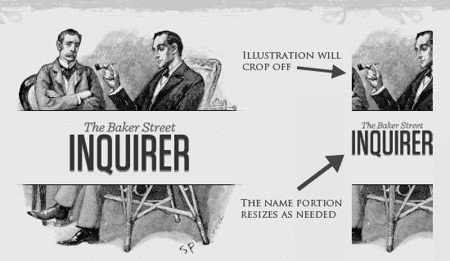

Slide 97

Images automatically adjusted and also the content of that web site adjusts to the screen of a same website.

Slide 98



How a website is structured, how information is spread through the website and how critical is the content for the particular purpose of the website are some key considerations while designing navigational elements for a responsive website.
Component Of Website
Home
About Us
Products
Gallery
Contact

Slide 99







A fluid grid is a way of defining a layout in terms of proportions. Thus, when the dimensions of a screen are shrunk, the layout with all elements will reduce in proportion.

Slide 100








When any device is requesting for a web site then images get flexible for that device.
With the help of media queries, you can also add flexible image sizes and embed flexible video displays on your responsive website.
Adjust Images
Flexible Images

Slide 101




Without media queries, responsive websites wouldn’t have been where they are today. With CSS3 media queries, you can conditionally apply CSS styles depending on the screen size.
Media queries are applied to the CSS code to load specific style elements according to the width of the screen.
Screen Resolution
Layouts

Slide 102
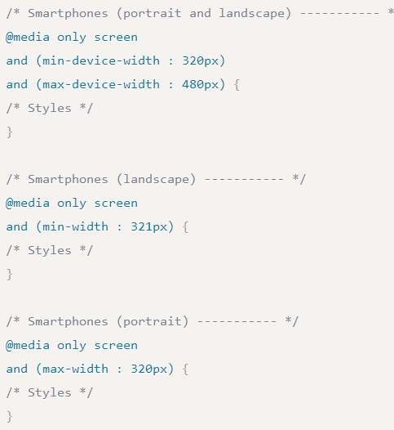
New CSS3 features also include orientation (portrait vs. landscape), device-width, min-device-width and more.
One can create multiple style sheets, ranges of widths —
even for landscape vs. portrait orientations.

Slide 103








